Slide 1

Offline Web Apps
HTML
Application Cache
JS
Service worker
Created by: Arthur Putnam
https://www.facebook.com/arthur.putnam

Slide 2
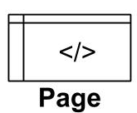
Offline Web Apps?....
Internet

Slide 3
Offline Benefits
Improving UX
Apps that act like native apps
Providing an offline experience
Reduce data usage
Increase device battery life
increase load times
faster deployment, larger reach
build once, deploy ever where
Required for progressive web apps
Data redundancy

Slide 4
Show examples
https://serviceworke.rs/

Slide 5
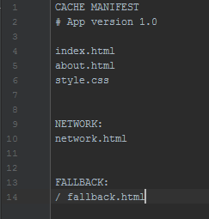

Application Cache

Slide 6
Application cache live example
http://arthurputnam.com/playground/app_cache/basic/index.html

Slide 7


Service Worker – what it does
Host

Slide 8
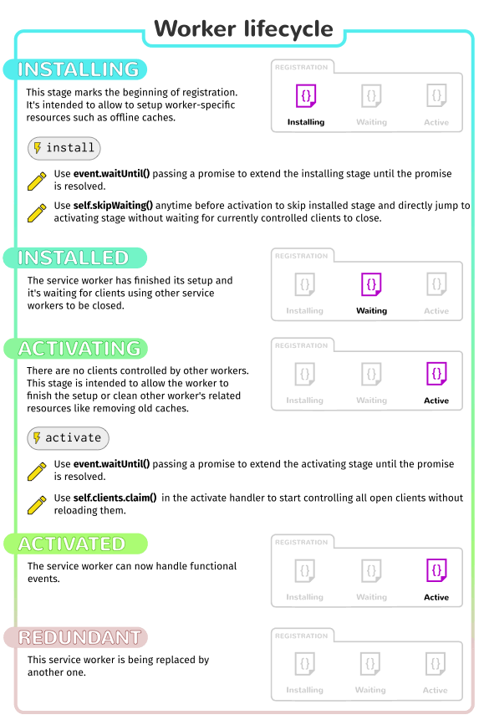
Service Worker - lifecycle
Source: https://mdn.mozillademos.org/files/12636/sw-lifecycle.png

Slide 9
Service Worker – Examples
https://github.com/ajputnam

Slide 10
Electron &| Cordova
https://github.com/sindresorhus/awesome-electron
http://photonkit.com/components/

